Slide 1
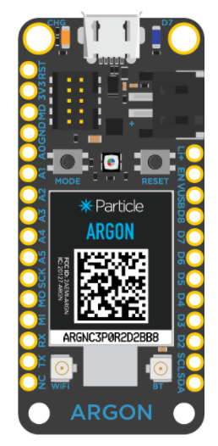
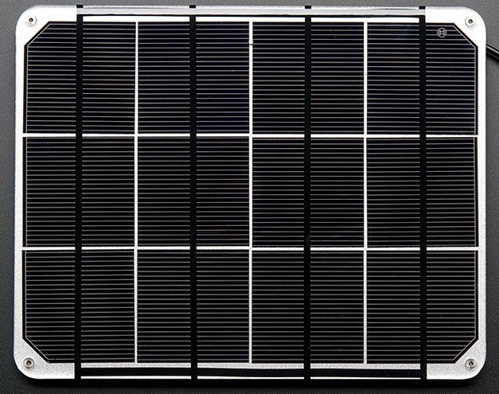
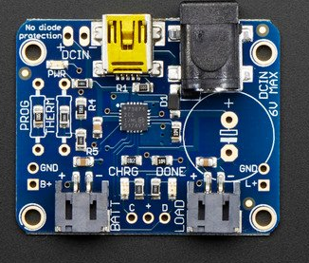

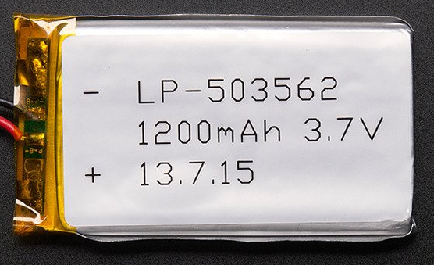
Gateway Schematic
Argon- Gateway
Solar Panel
LiPo Charger
Mesh
Antenna
WiFi
Antenna
LiPo Battery

